Slide 1
Capstone Project - The Battle of Neighborhoods
Yizhou Ding
10/21/2019

Slide 2
Introduction
The first known Chinese restaurant in America, Canton Restaurant, opened in San Francisco in 1849. Today, the cuisine has become a favorite throughout the country, with nearly 50,000 Chinese restaurants across the U.S.
In this project, we would examine a good location to open a Chinese restaurant in New York City, which has a strong Chinese demographic.

Slide 3
Data Source and Methodology
Public New York City data that contains the latitude and longitude
Foursquare API

Slide 4
Download New York geographic data
Query the Chinese restaurant information for each of the neighborhood using Foursquare API
Conclude where is the best location to open a new Chinese restaurant based on the data on hand

Slide 5
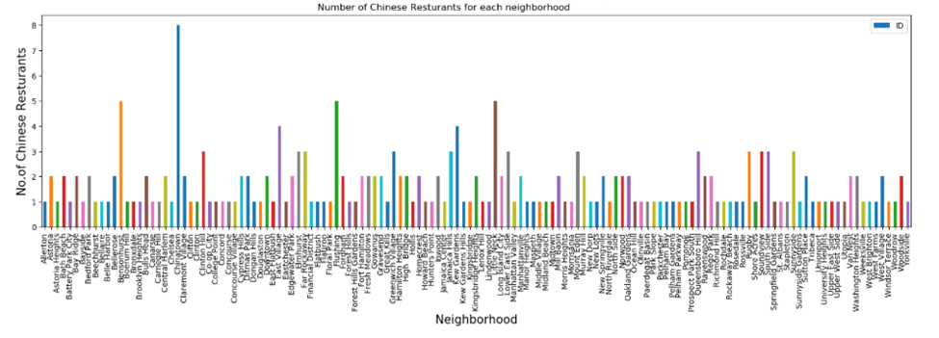
Data Analysis
Number of Chinese restaurants in each neighborhood

Slide 6
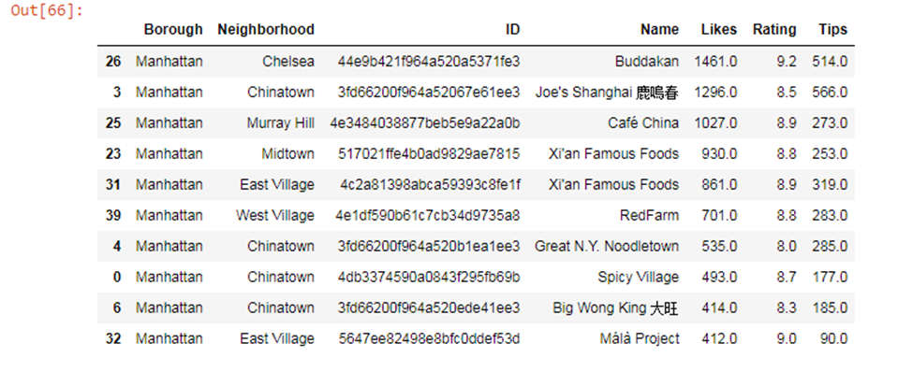
Most popular Chinese restaurant in New York City with most likes

Slide 7
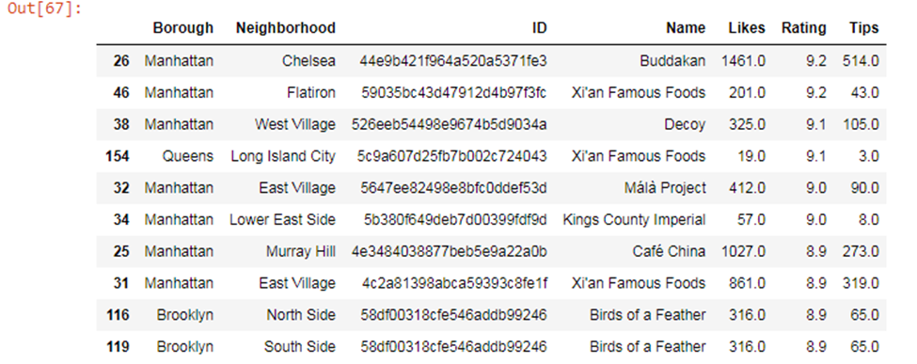
Chinese restaurants with highest quality

Slide 8
Buddakan, Xi'an Famous Foods, Málà Project are in both lists
Location of the restaurant is very important
Shanghai cuisine, Xi'an cuisine and Sichuan cuisine are popular in New York

Slide 9
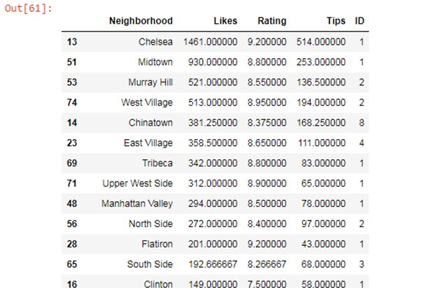
Average Likes, Rating and Tips of the Chinese restaurants in each neighborhood

Slide 10
Chelsea has the only Chinese restaurant Buddakan which is the top Chinese restaurant in New York, so it has highest number of likes, rating and tips.
Midtown has another good Chinese restaurant Xi'an Famous Food, so it has second highest number of likes.
The Chinese restaurants in Murray Hill, West Village, Chinatown and East Village are also quite popular in average. So to open a new Chinese restaurant, we can consider these areas based on the data we have.

Slide 11
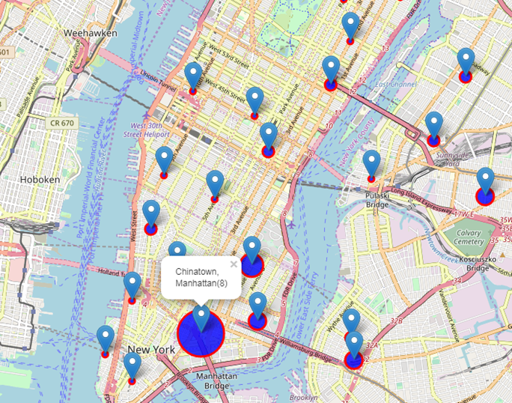
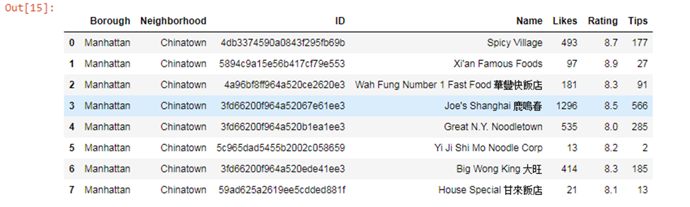
Chinatown

Slide 12
Eight Chinese restaurants in Chinatown, which makes the neighborhood competitive. Three of them are good restaurants: Joe's Shanghai has 1296 likes, Xi'an Famous Food has 8.9 rating, Spicy Village has 8.7 rating.
Need careful consideration if want to open a another Chinese restaurant in Chinatown.

Slide 13
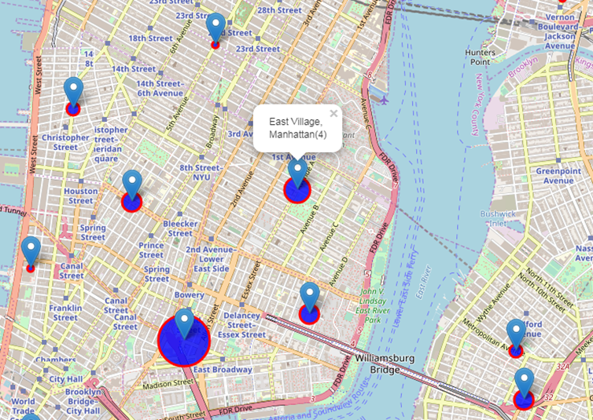
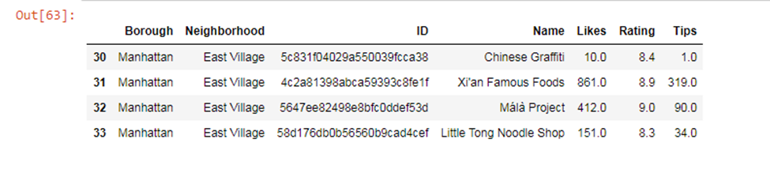
East Village

Slide 14
Four Chinese restaurants in East Village.
Two good restaurants: Xi'an Famous Food has 8.9 rating and 861 likes; Málà Project has 9.0 rating and 412 likes.
So if we want to open a Chinese restaurant here, we can try to open a Shanghai cuisine restaurant.

Slide 15
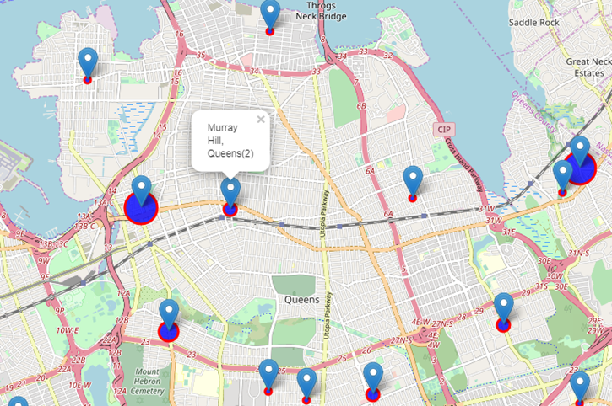
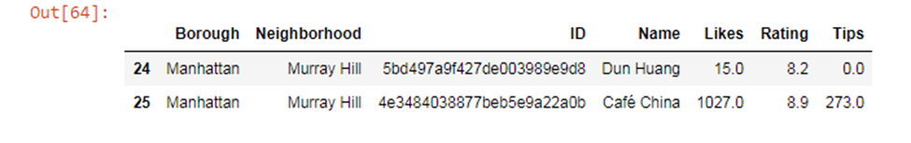
Murray Hill

Slide 16
Two Chinese restaurants in Murray Hill.
Café China has 8.9 rating and 1027 likes.
So we can try to open a Shanghai cuisine, Xi'an cuisine or Sichuan cuisine restaurant.

Slide 17
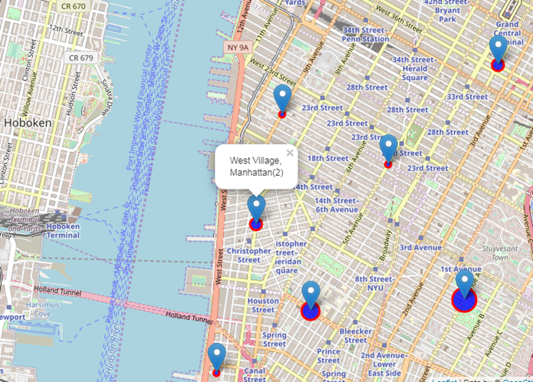
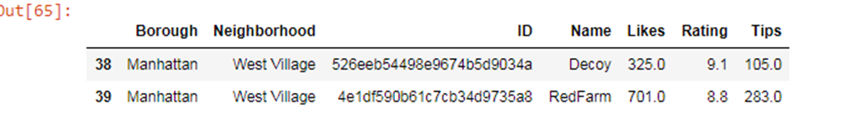
West Village

Slide 18
Two Chinese restaurants in West Village. Both of them have high ratings, which makes the neighborhood competitive.
Neither of them belongs to Shanghai cuisine, Xi'an cuisine or Sichuan cuisine, so we can also try to open one restaurant here.

Slide 19
Conclusion
Chinese restaurants in Murray Hill, West Village, and East Village are popular in average
Also not so competitive comparing with Chinatown for Chinese restaurants
Shanghai cuisine, Xi'an cuisine and Sichuan cuisine are popular in New York
Open a Shanghai cuisine restaurant in East Village, or a Shanghai cuisine, Xi'an cuisine or Sichuan cuisine in Murray Hill and West Village

